Slide 1

TestNG Installation

Slide 2
Introduction
TestNG is a testing framework for the Java programming language inspired from JUnit .
Installation is the process of making hardware and/or software ready for use.
A test case is a set of conditions or variables under which a tester will determine whether a system under test satisfies requirements or works correctly.
The process of developing test cases can also help find problems in the requirements or design of an application.

Slide 3
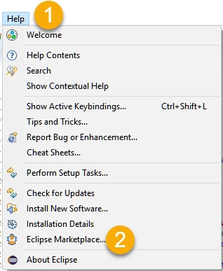
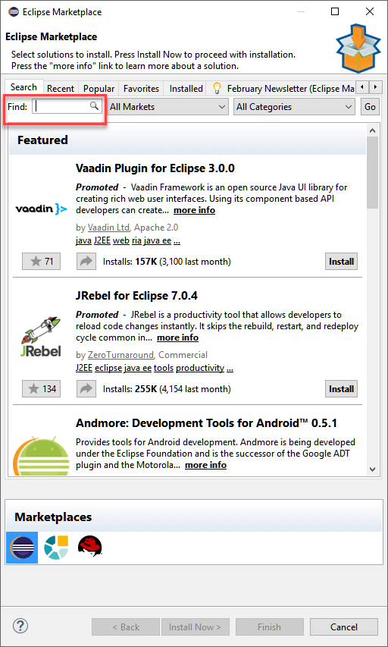
Installation of TestNG
Step 1:-
Launch Eclipse.
On the menu bar, click Help.
Choose the "Eclipse Marketplace..." option.
Step 2:-In the Eclipse Marketplace dialog box, type TestNG in the search box and press the search button( magnifying glass) or press enter key.

Slide 4
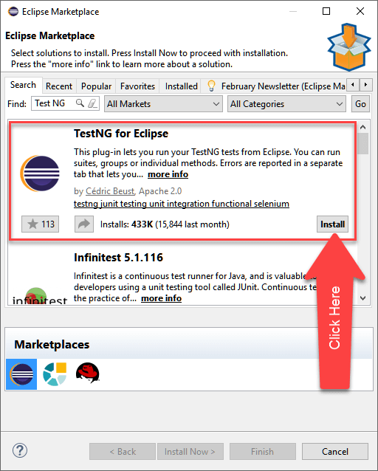
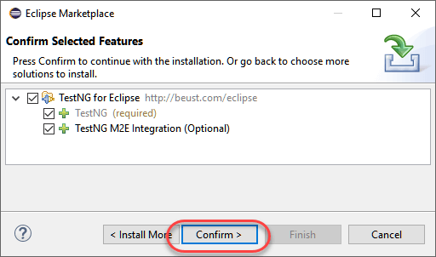
Step 3:- Click Install
Step 4: A new window for feature selection will open,Do not change anything and Click on confirm button.

Slide 5
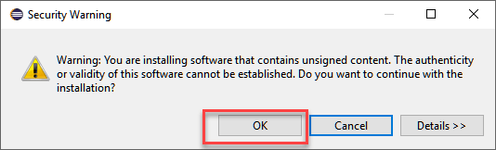
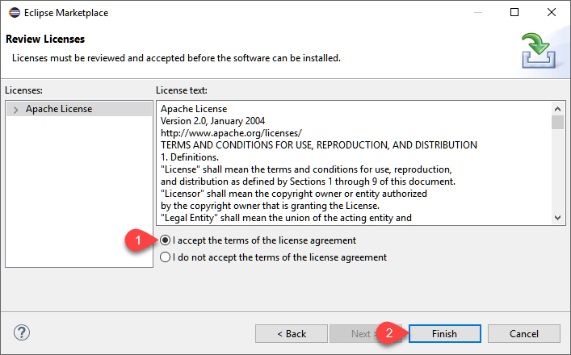
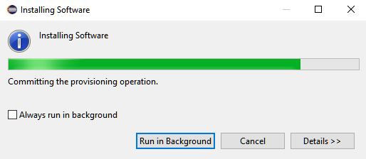
Step 5:-
Click Next again on the succeeding dialog box until you reach the License Agreement dialog.
Click "I accept the terms of the license agreement" then click Finish.
Step 6: -
If you encounter a Security warning, just click OK.
Wait for the installation to finish.

Slide 6
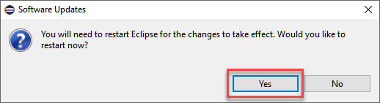
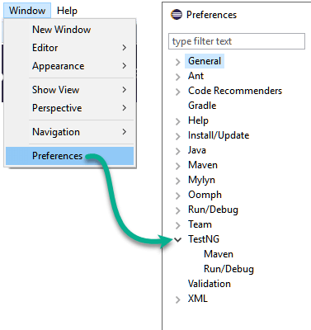
Step 7:- When Eclipse prompts you for a restart, just click Yes.
Step 8:- After the restart,verify If TestNG was indeed successfully installed. Click Window >Preferences and see if TestNG is included on the Preferences list.

Slide 7
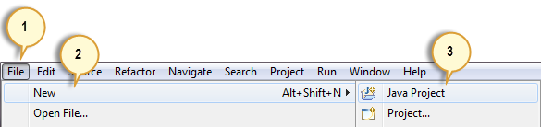
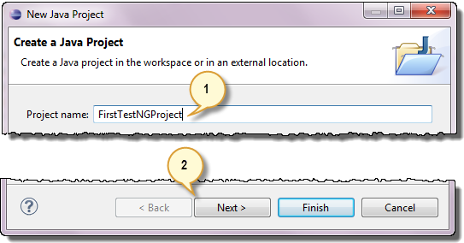
Creating Test case in testNG
1) Setting up a new TestNG Project:-
Step 1: Click File > New > Java Project.
Step 2: Type "FirstTestNGProject" as the Project Name then click Next.

Slide 8
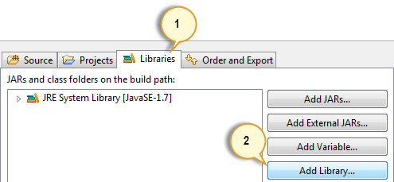
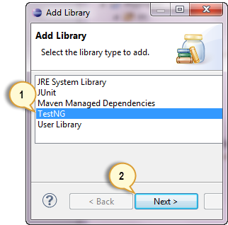
Step 3: Now start to import the TestNG Libraries onto our project. Click on the "Libraries" tab, and then “Add Library…”
Step 4: On the Add Library dialog, choose "TestNG" and click Next.

Slide 9
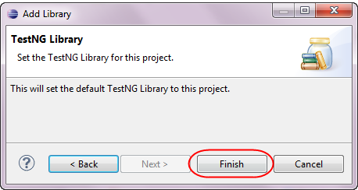
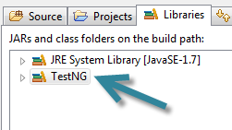
Step 5: Click Finish.
TestNG is included on the Libraries list see here:-

Slide 10
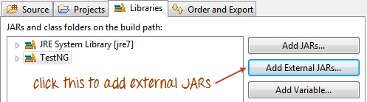
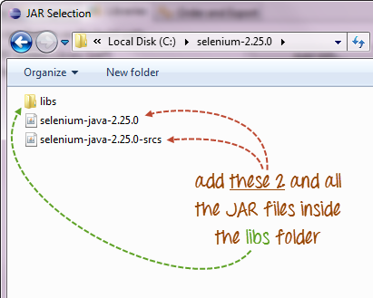
Step 6:Now add the JAR files that contain the Selenium API. These files are found in the Java client driver that we downloaded when we were installing Selenium and Eclipse .
Now navigate to where you have placed the Selenium JAR files.

Slide 11
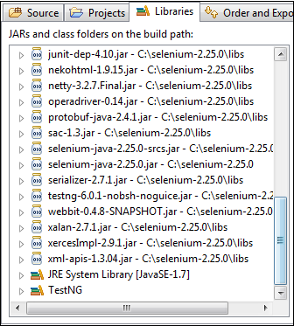
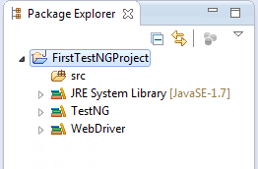
After adding the external JARs, Screen look like this:-
Step 7: Click Finish and verify that our FirstTestNGProject is visible on Eclipse's Package Explorer window.

Slide 12
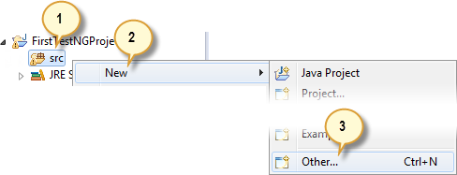
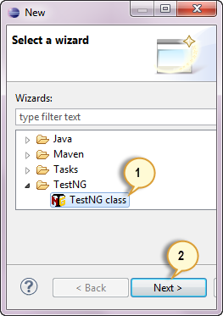
2) Creating a New TestNG Test File:-
Step 1: Right-click on the "src" package folder then choose New > Other…
Step 2: Click on the TestNG folder and select the "TestNG class" option. Click Next.

Slide 13
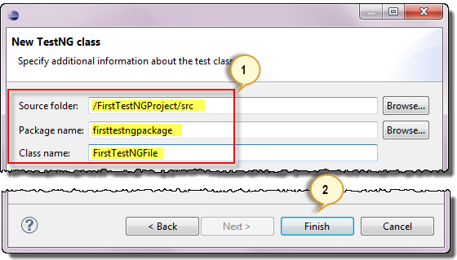
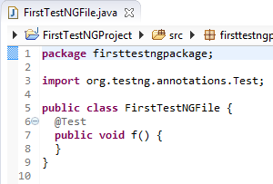
Step 3: Type the values indicated below on the appropriate input boxes and click Finish.
Eclipse should automatically create the template for TestNG file shown here:-

Slide 14
Covered Till Now
Installation is the process of making hardware and/or software ready for use.
A test case is a set of conditions or variables under which a tester will determine whether a system under test satisfies requirements or works correctly.
The process of developing test cases can also help find problems in the requirements or design of an application.
Installation of TestNG.
Creating a test case in TestNG.

Slide 15
Thanks

